Slide 1
Ase Lab Report
Submitted by Nusum Subba Reddy

Slide 2
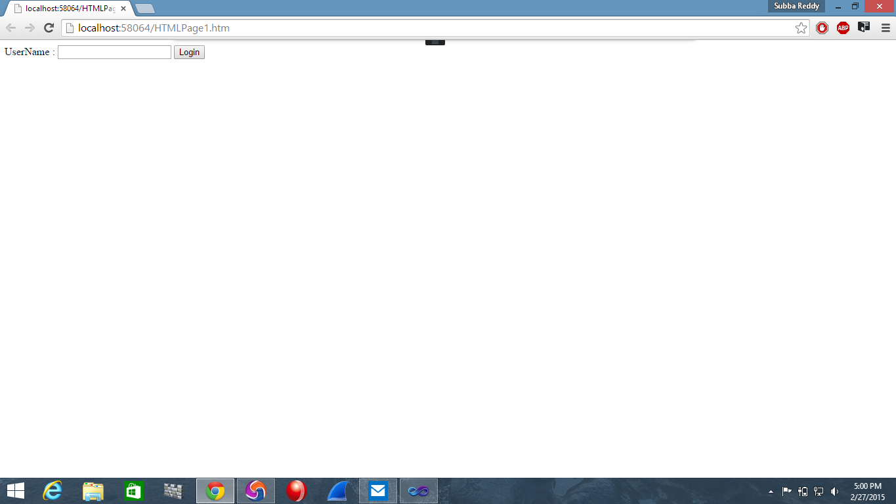
Task:
To create log-in service as rest service and show the log-in service URL in separate tab.
Output:

Slide 3
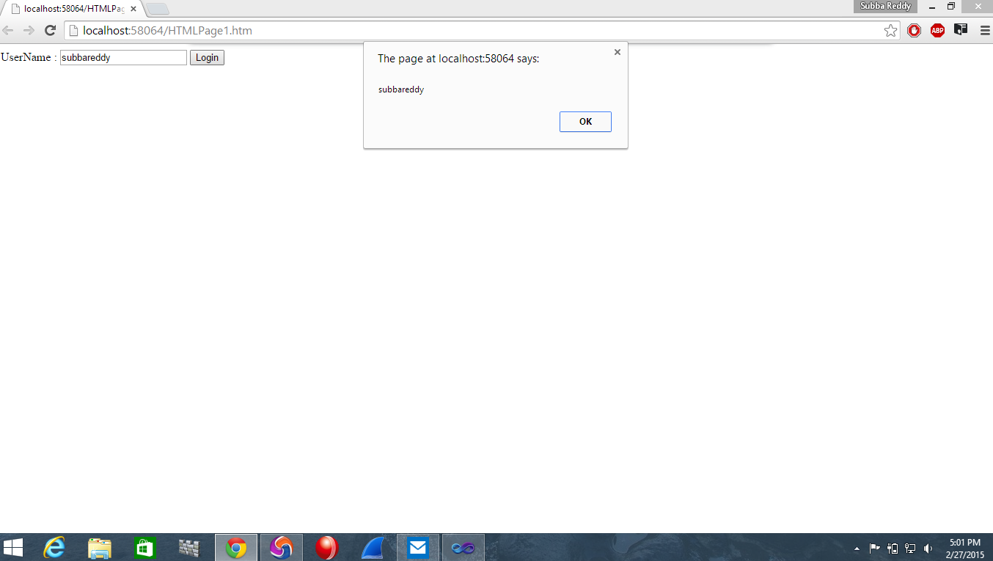

Slide 4
